Slide 1


Computer Applications to Behavioral Sciences
Lecture 10. Text File Processing
https://psychology-courses.appspot.com/
Dr. Jibo He
Wichita State University
hejibo@gmail.com

Slide 2
File Processing
A text file can be thought of as a sequence of lines
touch-event-log-file.txt

Slide 3
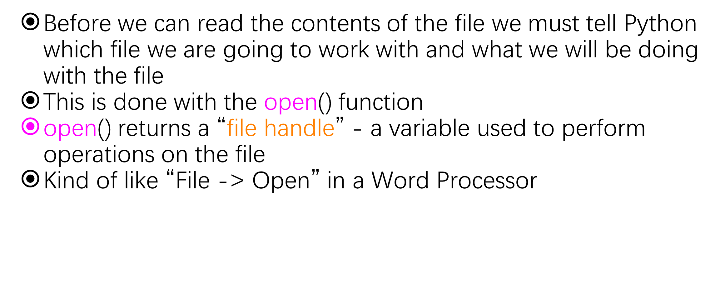
Using open()

Slide 4
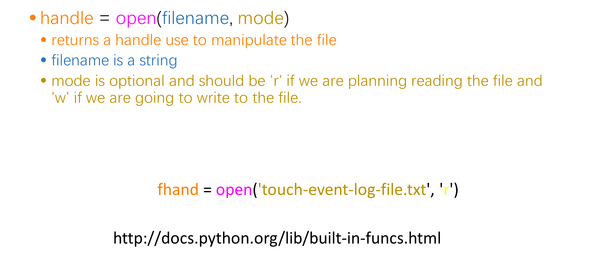

Slide 5
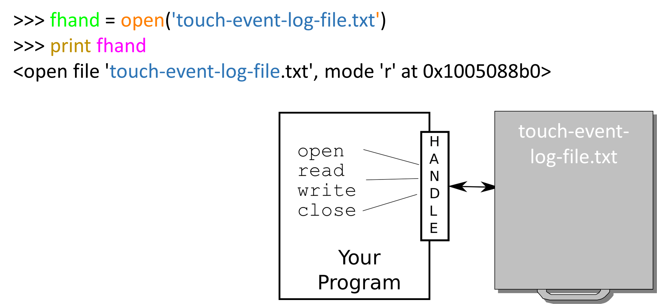
What is a Handle?

Slide 6
When Files are Missing
>>> fhand = open('stuff.txt')
Traceback (most recent call last): File "<stdin>", line 1, in <module>IOError: [Errno 2] No such file or directory: 'stuff.txt'

Slide 7
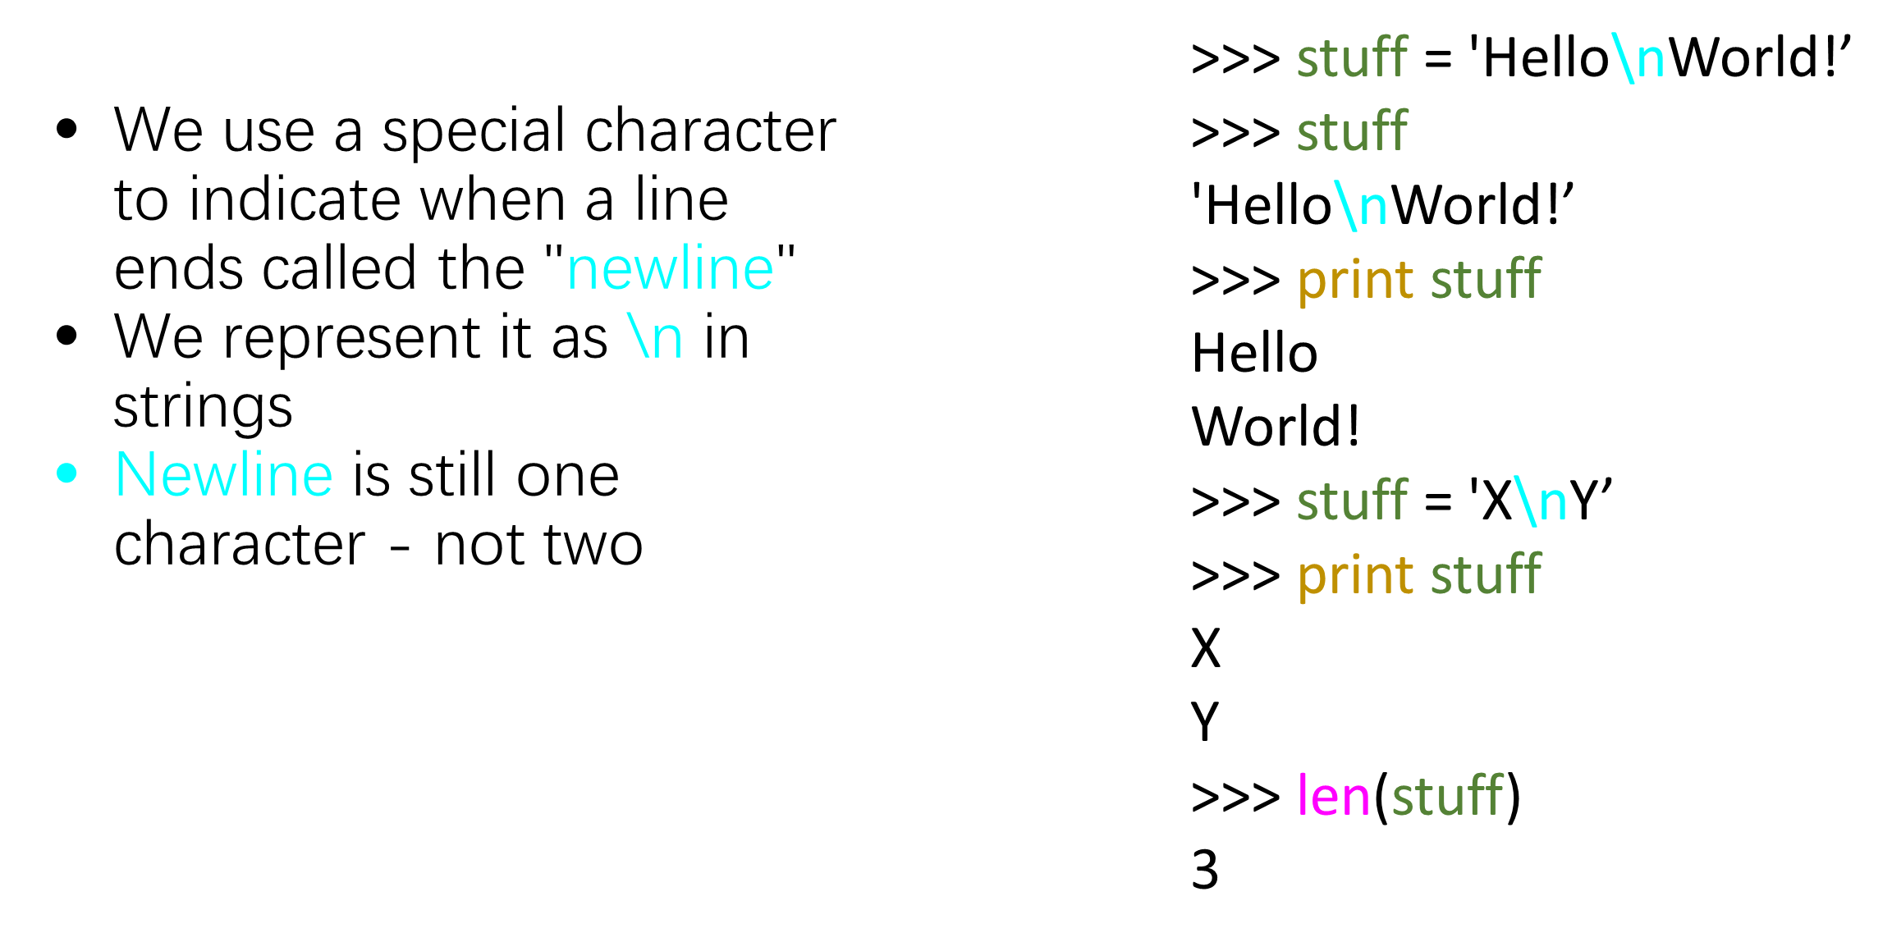
The newline Character

Slide 8
File Processing
A text file can be thought of as a sequence of lines
touch-event-log-file.txt

Slide 9
Tuples are Comparable
A text file has newlines at the end of each line
touch-event-log-file.txt
[1403887977.463725] /dev/input/event1: 0003 0035 00000327\n
[1403887977.463729] /dev/input/event1: 0003 0036 00000257\n
[1403887977.463735] /dev/input/event1: 0003 003a 0000001d\n
[1403887977.463739] /dev/input/event1: 0000 0000 00000000\n
[1403887977.543884] /dev/input/event1: 0003 0035 0000032c\n
[1403887977.543891] /dev/input/event1: 0003 0036 00000245\n
[1403887977.543895] /dev/input/event1: 0003 0030 00000004\n
[1403887977.543901] /dev/input/event1: 0000 0000 00000000\n
[1403887977.555953] /dev/input/event1: 0003 0036 00000242\n
[1403887977.555965] /dev/input/event1: 0000 0000 00000000\n

Slide 10
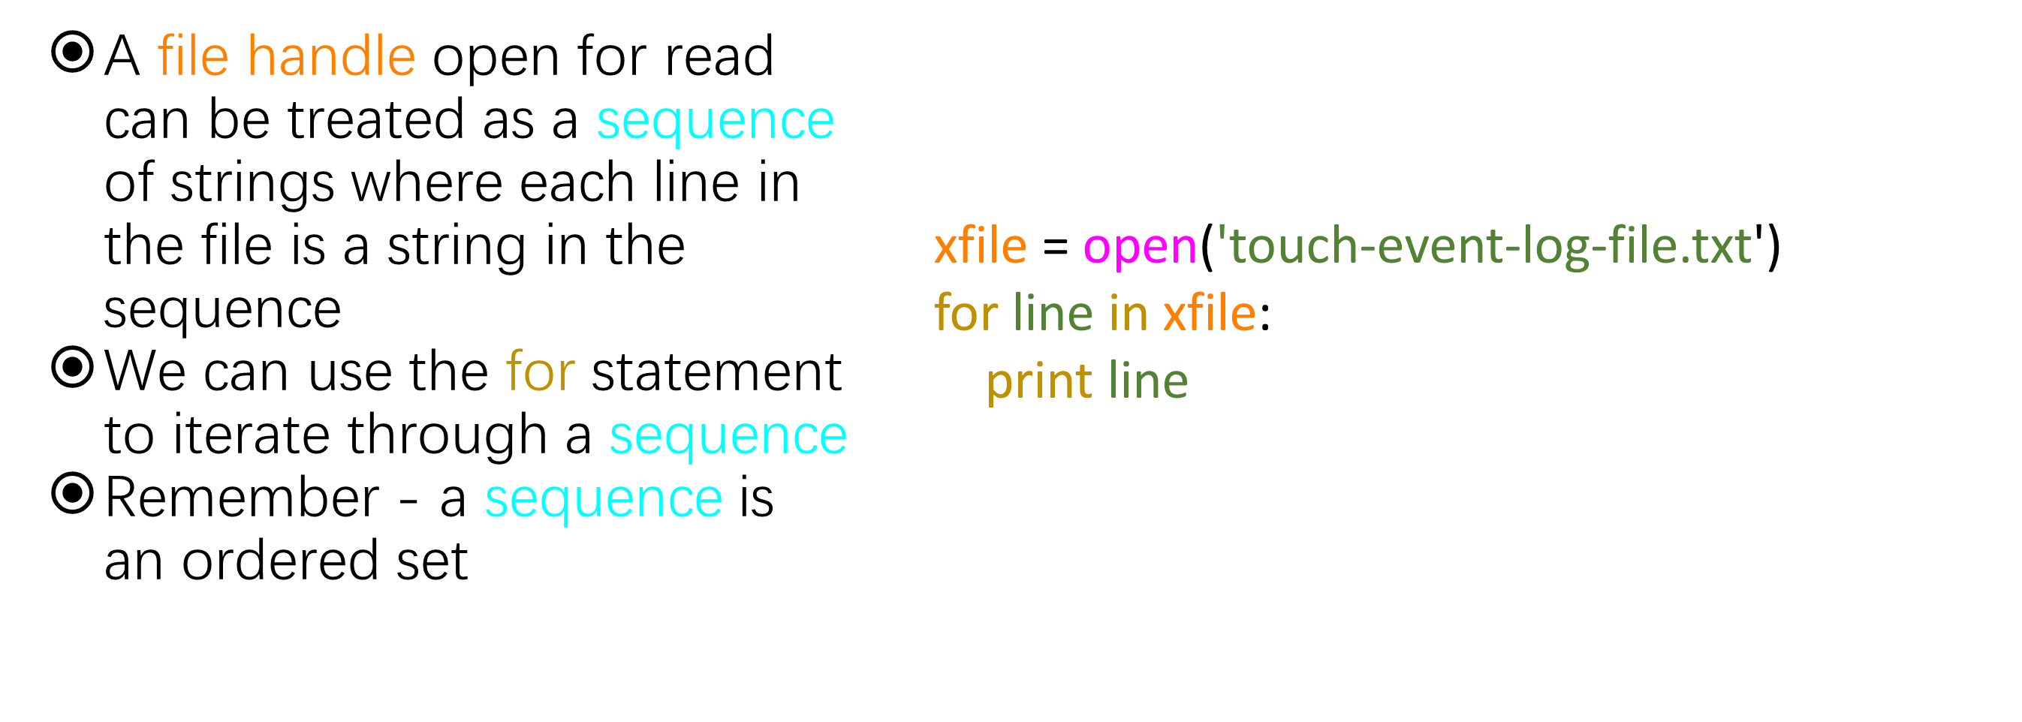
File Handle as a Sequence

Slide 11
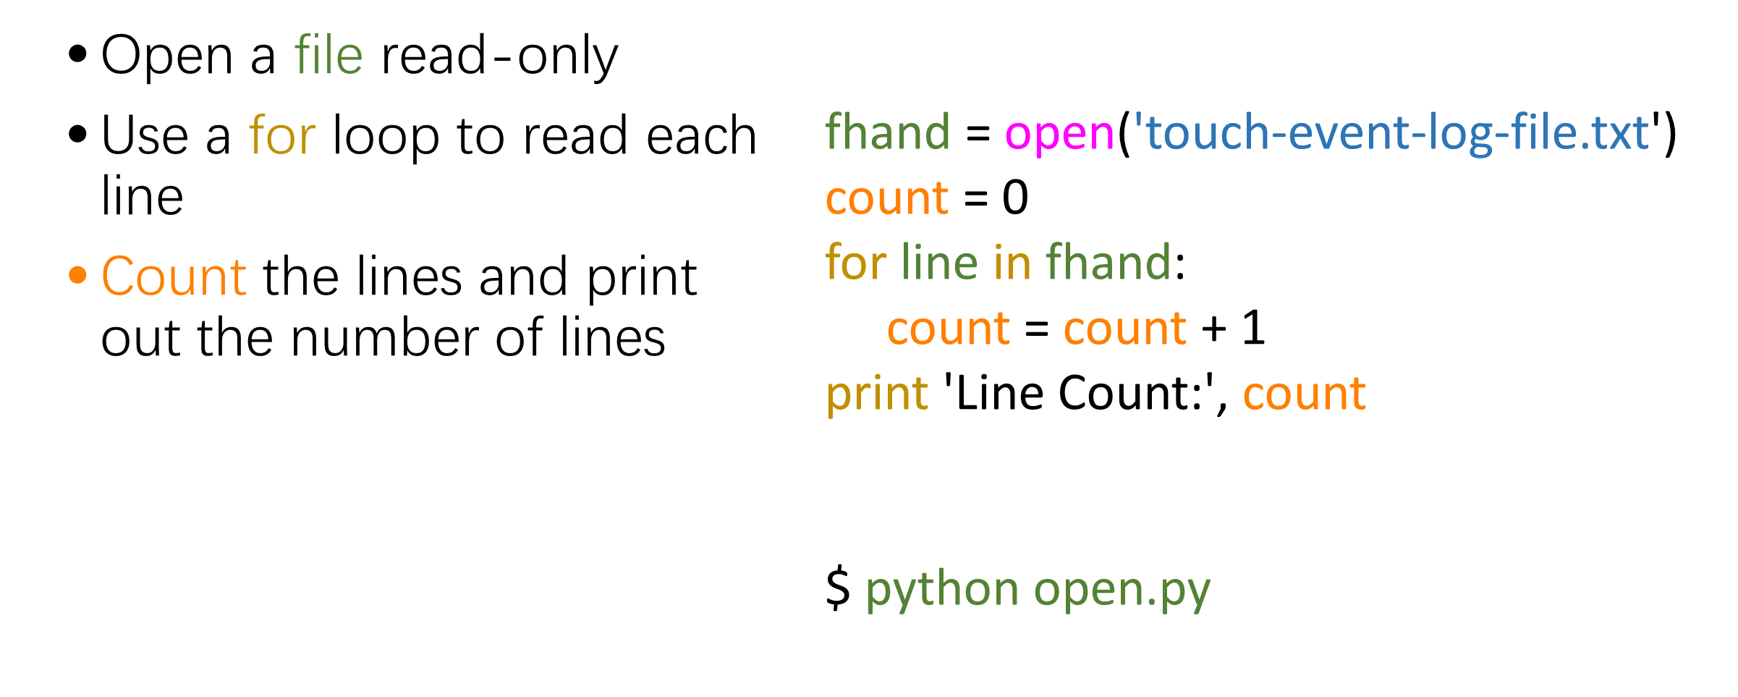
Counting Lines in a File

Slide 12
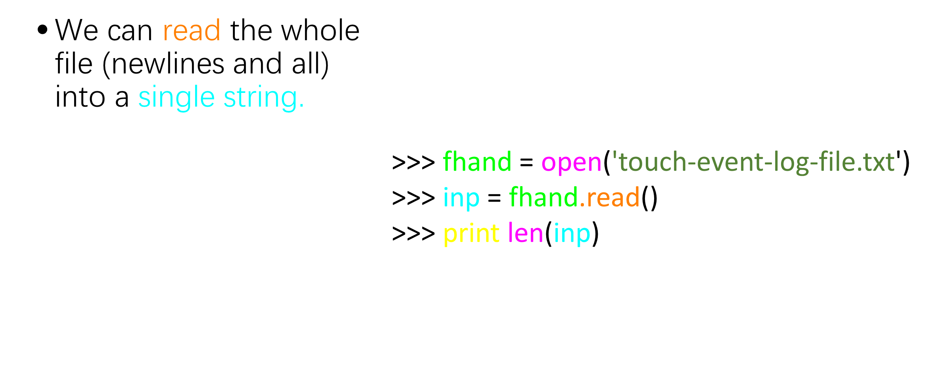
Reading the *Whole* File

Slide 13
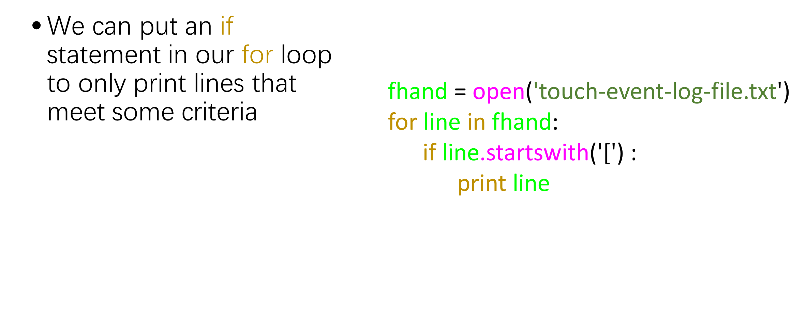
Searching Through a File

Slide 14
Write a File
'''
Jibo He @ WSU
demonstrate how to write a file.
September 24, 2014
'''
fhand = open('HelloWorld.txt','w')
print >>fhand,"Hello World"
fhand.close()

Slide 15
Write a File
'''
Jibo He @ WSU
demonstrate how to write a file, print “Hello World” multiple times
September 24, 2014
'''
fhand = open('HelloWorld.txt','w')
for i in range(10):
print >>fhand,"Hello World"
fhand.close()

Slide 16
Tab delimitated file
'''
Jibo He @ WSU
demostrate how to write a tab delimitated file.
September 24, 2014
'''
fhand = open('tabbedfile.txt','w')
for i in range(10):
print >>fhand,1,'\t',2,'\t',3
fhand.close()

Slide 17
Open Multiple CSV Files
import csv
import numpy as np
pm=[]
for i in range(1,28):
f=open('beijing_all_201802{}.csv'.format(str(i).zfill(2)),encoding='utf-8')
f=csv.reader(f)
for line in f:
if line[2]=='PM2.5’:
pm.append(line[26])
Notes:
See assignment_3_python_3_QinyuCao_1600011627

Slide 18
Summary
Opening a file - file handle
File structure - newline character
Reading a file line-by-line with a for loop
Searching for lines
Write a file

Slide 19
Thank You

